Slide 1

Data Structures and Algorithms
Notes, Minimum Spanning Trees

Slide 2
Motivations for MSTs
Great application of greedy algorithms
In LANs, where routing must be very quick, it is often done by having a fixed table such that all traffic entering a given node N that is destined for some faraway node X will be sent to the same node next (M).
This avoids any possibility of circular routing.
Many other odd uses
Image recognition
Handwriting analysis

Slide 3
Generic MST Algorithm
All MST algorithms are versions of a generic greedy algorithm for a graph G = (V,E).
Let edge set A ⊆ E be part of an MST for G. Let (u,v) ∈ E.
Call an edge (u,v) safe for A if A ∪ (u,v) is part of an MST for G.
Generic_MST {
A = ∅;
while (A is not a spanning tree) {
find an edge (u,v) that is “safe” for A;
if no such edge, mark A as MST;
else A = A ∪ (u,v);
}
return A;
}

Slide 4
Generic MST Algorithm – Loop Invariant
Generic_MST {
A = ∅;
while (A is not a spanning tree) {
find an edge (u,v) that is “safe” for A;
A = A ∪ (u,v);
}
return A;
}
Loop Invariant: Prior to each iteration, A is a subset of some MST
Remember, a loop invariant has three properties:
Initialization: It’s true before the loop is entered.
Maintenance: It’s true at the beginning of each iteration of the loop.
Termination: It’s true when the loop exits.

Slide 5
Loop Invariant Proof Outline
Generic_MST {
A = ∅;
while (A is not a spanning tree) {
find an edge (u,v) that is “safe” for A;
A = A ∪ (u,v);
}
return A;
}
Initialization: At the start, null set of edges is not a spanning tree.
Maintenance: We wouldn’t get into the loop if A had a loop or were a complete spanning tree.
Termination: When the loop exits, we couldn’t find another edge to add, so it’s a spanning tree.

Slide 6
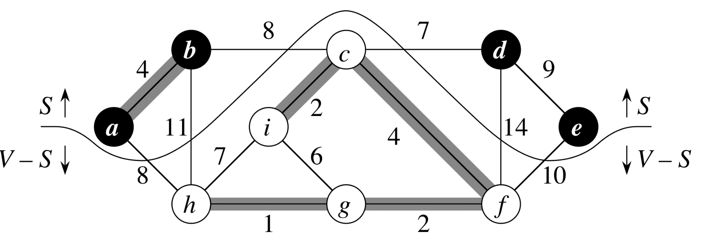
Cut Property
“Let G = (V,E) be a connected, undirected graph with a real-valued weight function w defined on E. Let A be a subset of E that is included in some MST for G, let (S, V-S) be any cut of G that respects A, and let (u,v) be a light edge crossing (S,V-S).” Then edge (u,v) is in some MST of G.
Note that this is a form of “Greedy Choice property”

Slide 7
Proof Outline of Cut Property
This works because the lightest edge joining two disjoint subsets of a graph in a tree can always be part of some MST. If it were not part of any MST:
Take one MST
Add the lightest edge crossing the cut, creating a cycle
Remove some other edge of this cycle that crosses the boundary between disjoint subsets
You now have a spanning tree with a cost no higher than before.

Slide 8
Kruskal’s Algorithm
Repeatedly add the next lightest edge that doesn’t produce a cycle.
Here the cut is between any two parts of the graph that don’t have an edge between them, but that are joined by the lightest weight edge not in the tree that doesn’t form a cycle.
We will discuss the idea, but not the details of the implementation
Best implementation uses data structures we won’t cover in this class.

Slide 9
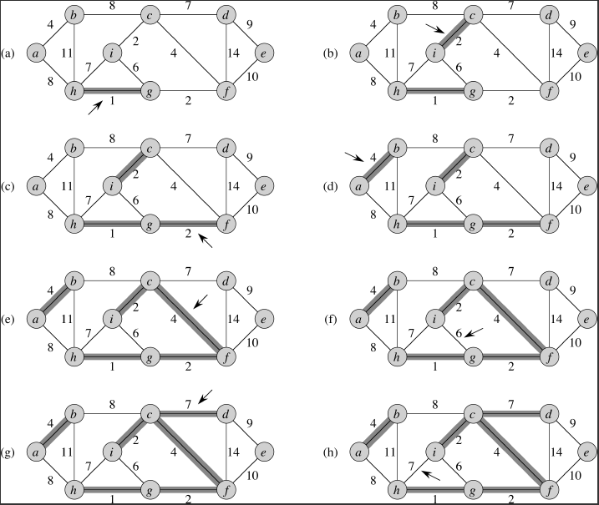
Kruskal Example

Slide 10
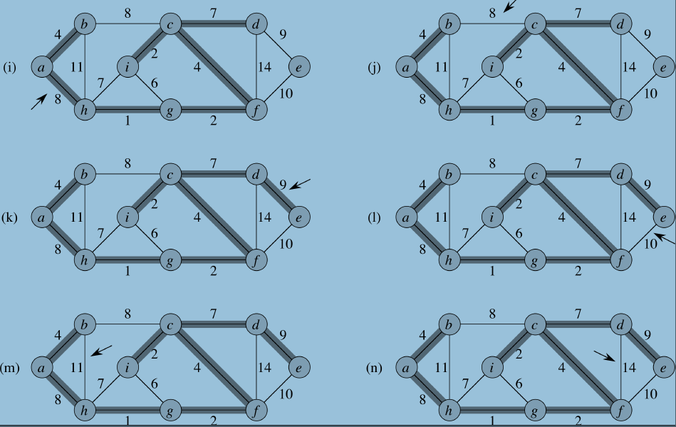
Kruskal Example, cont.
u.π = NIL

Slide 11
Kruskal’s Algorithm, Pseudocode (Δ)
MST_Kruskal(G,w)
A = ∅ // A is the MST
for each vertex v ∈ G.V // O(V)
make v a set of one vertex
sort edges of G.E, light → heavy // O(E lg E)
for each edge (u,v) ∈ G.E, light → heavy
if u and v are in different sets
A = A ∪ (u,v) // For loop faster than O(E lg E)
merge sets containing u and v into one
return A

Slide 12
Kruskal’s Algorithm – Data Structures
Kruskal’s algorithm is quick, simple, and easy to understand.
To implement it efficiently, one usually uses either
Disjoint-set data structure
Fibonnacci heap
We didn’t study either of these, so we won’t discuss the implementation in detail.
But the running time is O(E lg E).

Slide 13
Prim’s Algorithm
Start with the partial MST being a single node (any node will do).
Add the lightest edge to the tree.
In the language of the cut property, the joined edges are the subset S. The rest of the tree is the subset V-S.
Pick the lightest edge between S and V-S
Move the newly joined vertex out of V-S and into S.

Slide 14
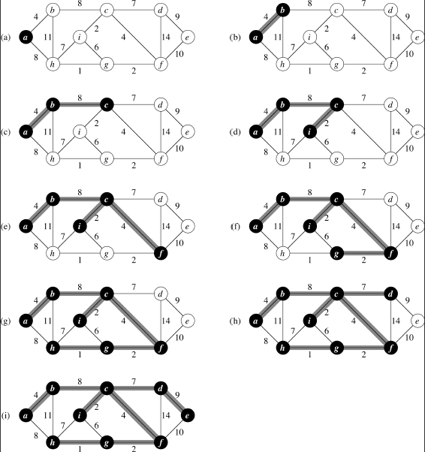
Prim’s Algorithm in Action

Slide 15
Prim’s Algorithm - Implementation
Prim’s Algorithm is often implemented by putting vertices into a priority queue.
A common data structure for the priority queue is a binary heap. Recall the running times of binary heap methods:
Build-Min-Heap: O(V)
Extract-Min: O(V lg V) (amortized over all calls)
Running time is O(V lg V + E lg V) = O(E lg V)
Can be lowered to O(E + V lg V) with Fibonacci heaps
Not covered

Slide 16
Prim’s Algorithm, Pseudocode
MST-Prim(G,w,r)
for each u ∈ G.V // init O(V)
u.key = ∞
u.π = NIL
r.key = 0
Q = G.V // O(V) (build heap)
while Q ≠ ∅ // O(V) times through the loop
u = Extract-Min(Q) // O(lg V) each time
for each v ∈ G.Adj[u] // O(E) times, amortized* if v ∈ Q and w(u,v) < v.key
v.π = u // O(lg V) in a heap
v.key = w(u,v) // O(1)
O(V lg V) + O(E lg V) = O(E lg V)
* - Not O(E) times per while loop, but O(E) times in total, because every edge is incident on two vertices.

